Slide 1
Neural Networks Semester 1 Laboratory works for GRIAT master program Teacher: Makhmutova Alisa AZMakhmutova@kai.ru

Slide 2
Tuning hyperparameters
Even in a simple MLP, you can change the number of layers, the number of neurons per layer, and the type of activation function to use in each layer. You can also change the weight initialization logic, the drop out keep probability, and so on.
Number of hidden layers
Number of neurons per hidden layer
Weight and biases initialization
Selecting the most suitable optimizer
Regularization
Dropout optimization
KNRTU-KAI | TU ILMENAU | Neural Networks

Slide 3
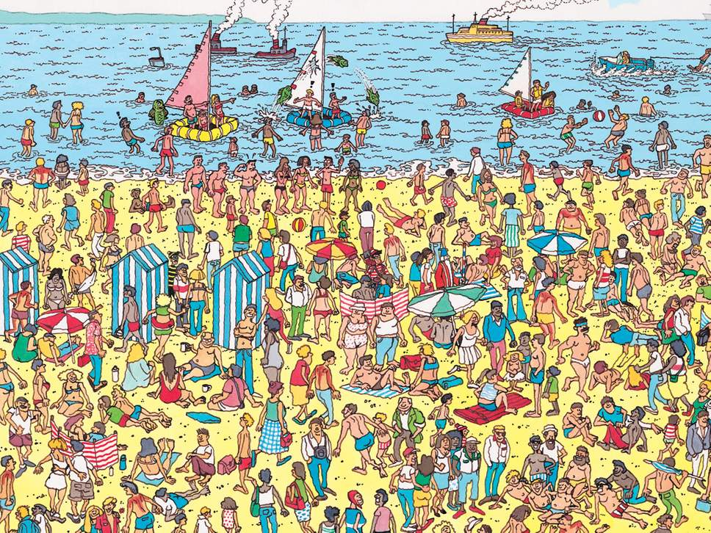
Convolutional Neural Networks
spatial invariance - not sensitive to the position of, for example, object in the picture
similarly to the same patch, regardless of where it appears in the image - translation invariance
focus on local regions, without regard for the contents of the image in distant regions - locality principle

Slide 4
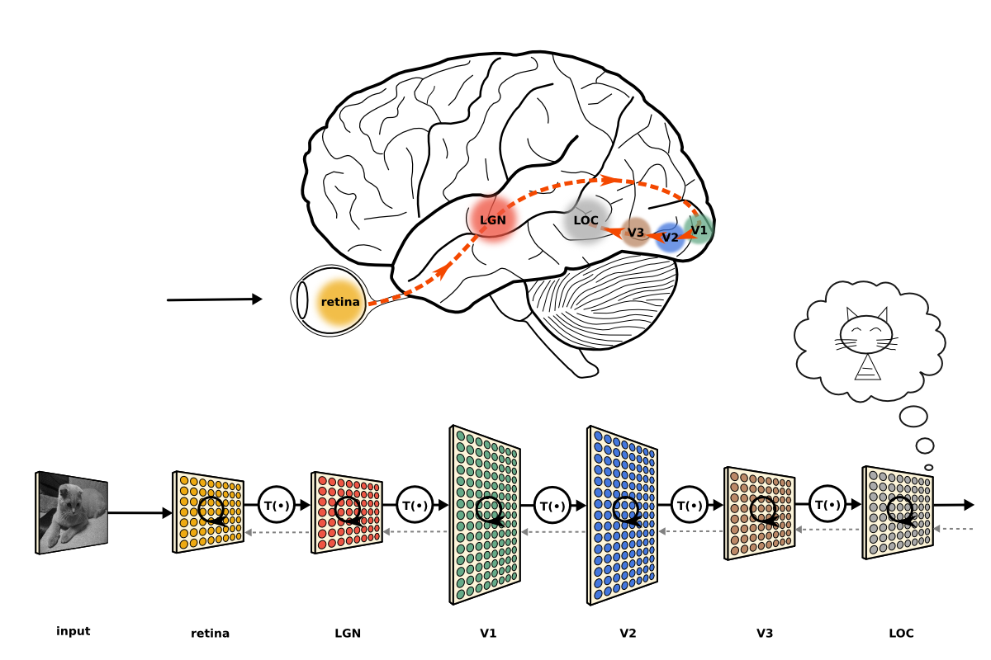
Convolutional Neural Networks

Slide 5
Convolutional Neural Networks
For the humans:
in the V1 zone, local features of small areas of image read from the retina stand out;
V2 continues to highlight local features, slightly summarizing them and adding binocular vision (i.e., the stereo effect of two eyes);
in the V3 zone, color, textures of objects are recognized, the first results of their segmentation and grouping appear;
zone V4 is already beginning to recognize geometric shapes and outlines of objects that are still simple; besides, it is here that the modulation is strongest through our attention: the activation of neurons in V4 is not uniform across the entire field of view, but depends strongly on what we are paying attention to, consciously or unconsciously;
the V5 zone is mainly engaged in the recognition of movements, trying to understand where and with what speed those objects move in sight, the outlines of which stood out in the V4 zone;
in the V6 zone, data about the whole picture is summarized; it reacts to changes throughout the field of view (wide-field stimulation) and changes in the picture due to the fact that the person himself moves;
sometimes also distinguish the V7 zone, where the recognition of complex objects, in particular human faces.
KNRTU-KAI | TU ILMENAU | Neural Networks

Slide 6
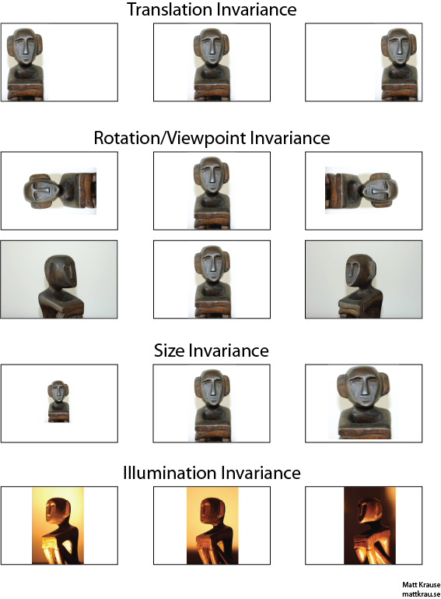
Convolutional Neural Networks

Slide 7
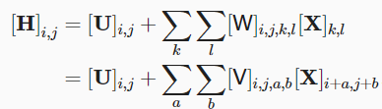



Convolutional Neural Networks
Translation Invariance
Locality

Slide 8
Convolutional Neural Networks
The convolutional neural network (CNN) is a neural network technology that has profoundly impacted the area of computer vision (CV). Fukushima (1980) introduced the original concept of a convolutional neural network, and LeCun, Bottou, Bengio & Haffner (1998) greatly improved this work. From this research, Yan LeCun introduced the famous LeNet-5 neural network architecture.
KNRTU-KAI | TU ILMENAU | Neural Networks

Slide 9
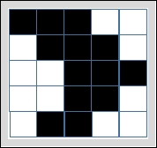
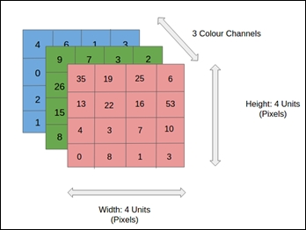
Main concepts of CNNs
In computer vision, it is well known that a real image is associated with a grid composed of a high number of small squares called pixels. The following figure represents a black and white image related to a 5×5 grid of pixels.
Each element in the grid corresponds to a pixel. In the case of a black and white image, a value of 1 is associated with black and a value of 0 is associated with white. Alternatively, for a grayscale image, the allowed values for each grid element are in the range [0, 255], where 0 is associated with black and 255 is associated with white.
Finally, a color image is represented by a group of three matrices, each corresponding to one color channel (red, green, and blue). Each element of each matrix can vary over an interval of 0 to 255 that specifies the brightness of the fundamental color (or base color). This is shown in the following figure, in which each matrix is 4×4 and the number of color channels is three

Slide 10

Convolutional Neural Networks
The 2D convolution is a fairly simple operation at heart: you start with a kernel, which is simply a small matrix of weights. This kernel “slides” over the 2D input data(input matrix or input image), performing an elementwise multiplication (scalar product) with the part of the input it is currently on, and then summing up the results into a single output pixel. The result is a new matrix called a convolution matrix.
$$\left[\begin{matrix}0 & 1 & 2 \\ 2 & 2 & 0 \\ 0 & 1 & 2\end{matrix}\right]$$
kernel
KNRTU-KAI | TU ILMENAU | Neural Networks

Slide 11
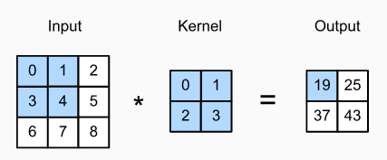
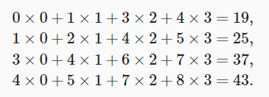
Convolutional Neural Networks
feature map

Slide 12
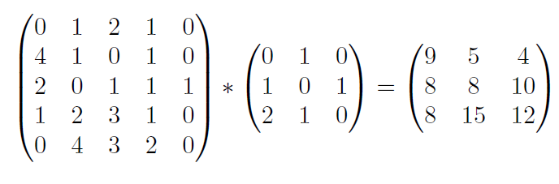
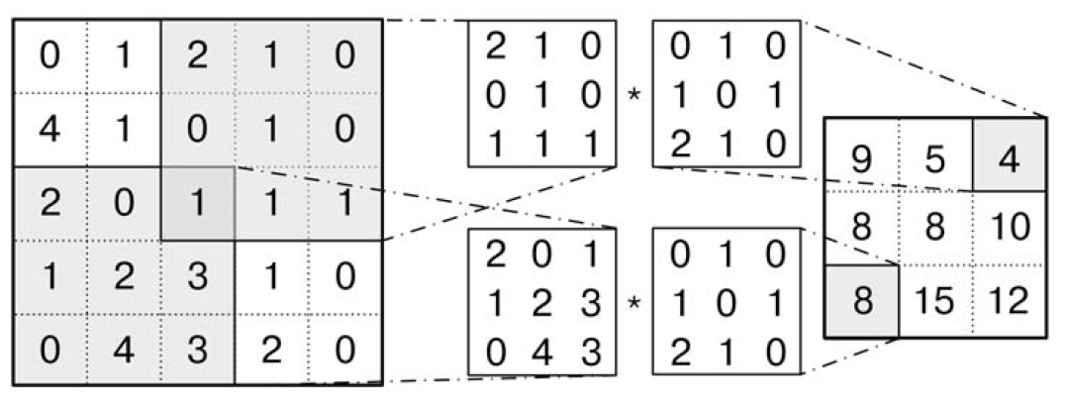
Convolutional Neural Networks
The kernel repeats this process for every location it slides over, converting a 2D matrix of features into yet another 2D matrix of features. The output features are essentially, the weighted sums (with the weights being the values of the kernel itself) of the input features located roughly in the same location of the output pixel on the input layer.
Whether or not an input feature falls within this “roughly same location”, gets determined directly by whether it’s in the area of the kernel that produced the output or not. This means the size of the kernel directly determines how many (or few) input features get combined in the production of a new output feature.
This is all in pretty stark contrast to a fully connected layer.
KNRTU-KAI | TU ILMENAU | Neural Networks

Slide 13
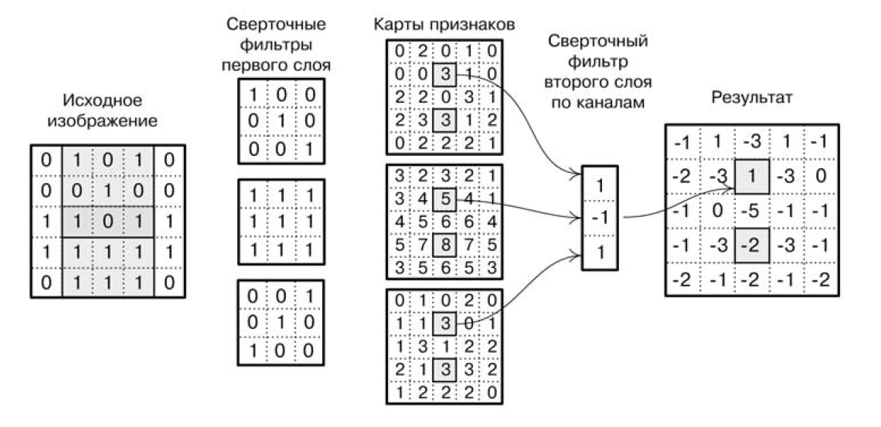
Convolutional Neural Networks
Feature map
Filters of the second layer by channels
First layer filters
Original image
Result
KNRTU-KAI | TU ILMENAU | Neural Networks

Slide 14
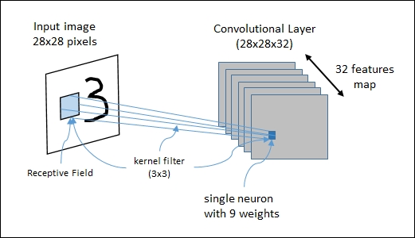
Convolutional Neural Networks
In a convolutional layer, each neuron is connected to a certain region of the input area called the receptive field. For example, using a 3×3 kernel filter, each neuron will have a bias and 9 weights (3×3) connected to a single receptive field. To effectively recognize an image, we need various different kernel filters to be applied to the same receptive field because each filter should recognize images from a different feature. The set of neurons that identifies the same feature defines a single feature map.
The following figure shows a CNN architecture in action: the 28×28 input image will be analyzed by a convolutional layer composed of a 28x28x32 feature map. The figure also shows a receptive field and a 3×3 kernel filter

Slide 15
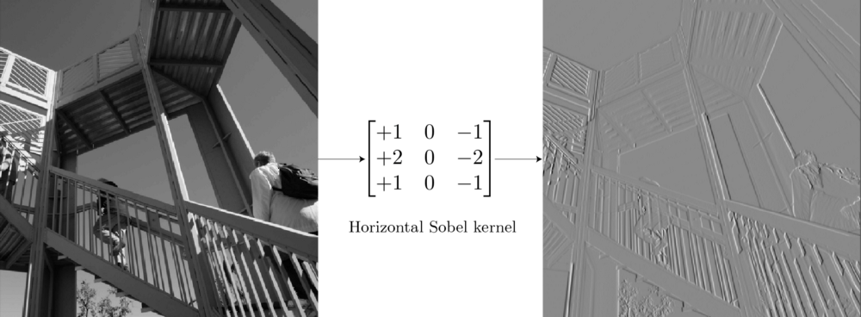
Convolutional Neural Networks
KNRTU-KAI | TU ILMENAU | Neural Networks

Slide 16
Convolutional Neural Networks - Padding
Padding: during the sliding process, the edges essentially get “trimmed off”, converting a 5×5 feature matrix to a 3×3 one. The pixels on the edge are never at the center of the kernel, because there is nothing for the kernel to extend to beyond the edge. This isn’t ideal, as often we’d like the size of the output to equal the input. Padding does something pretty clever to solve this: pad the edges with extra, “fake” pixels (usually of value 0, hence the oft-used term “zero padding”). This way, the kernel when sliding can allow the original edge pixels to be at its center, while extending into the fake pixels beyond the edge, producing an output the same size as the input.
KNRTU-KAI | TU ILMENAU | Neural Networks

Slide 17
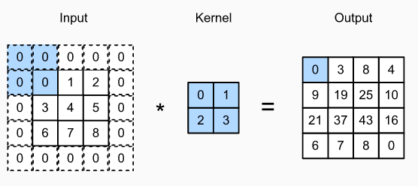
Convolutional Neural Networks - Padding

Slide 18
Convolutional Neural Networks - Strides
Striding: Often when running a convolution layer, you want an output with a lower size than the input. This is commonplace in convolutional neural networks, where the size of the spatial dimensions are reduced when increasing the number of channels. One way of accomplishing this is by using a pooling layer (eg. taking the average/max of every 2×2 grid to reduce each spatial dimensions in half). Yet another way to do is is to use a stride.
The idea of the stride is to skip some of the slide locations of the kernel. A stride of 1 means to pick slides a pixel apart, so basically every single slide, acting as a standard convolution. A stride of 2 means picking slides 2 pixels apart, skipping every other slide in the process, downsizing by roughly a factor of 2, a stride of 3 means skipping every 2 slides, downsizing roughly by factor 3, and so on.
KNRTU-KAI | TU ILMENAU | Neural Networks

Slide 19
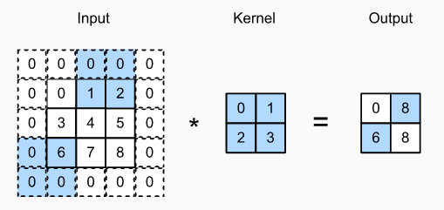
Convolutional Neural Networks - Strides

Slide 20
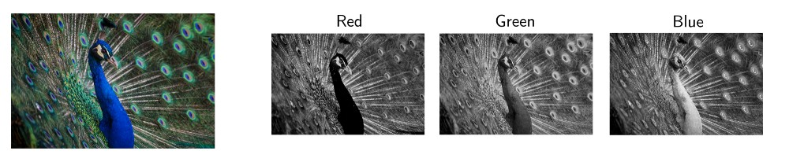
Convolutional Neural Networks
Of course, the diagrams above only deals with the case where the image has a single input channel. In practicality, most input images have 3 channels, and that number only increases the deeper you go into a network. It’s pretty easy to think of channels, in general, as being a “view” of the image as a whole, emphasizing some aspects, de-emphasizing others.
KNRTU-KAI | TU ILMENAU | Neural Networks

Slide 21
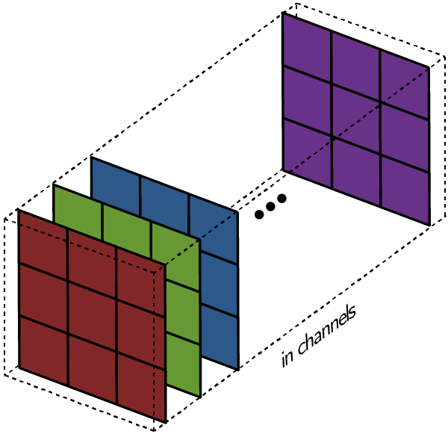
Multiple Input and Multiple Output Channels
So this is where a key distinction between terms comes in handy: whereas in the 1 channel case, where the term filter and kernel are interchangeable, in the general case, they’re actually pretty different. Each filter actually happens to be a collection of kernels, with there being one kernel for every single input channel to the layer, and each kernel being unique.
Each filter in a convolution layer produces one and only one output channel, and they do it like so:
Each of the kernels of the filter “slides” over their respective input channels, producing a processed version of each. Some kernels may have stronger weights than others, to give more emphasis to certain input channels than others (eg. a filter may have a red kernel channel with stronger weights than others, and hence, respond more to differences in the red channel features than the others).
KNRTU-KAI | TU ILMENAU | Neural Networks

Slide 22
Convolutional Neural Networks
Each of the per-channel processed versions are then summed together to form one channel. The kernels of a filter each produce one version of each channel, and the filter as a whole produces one overall output channel.

Slide 23
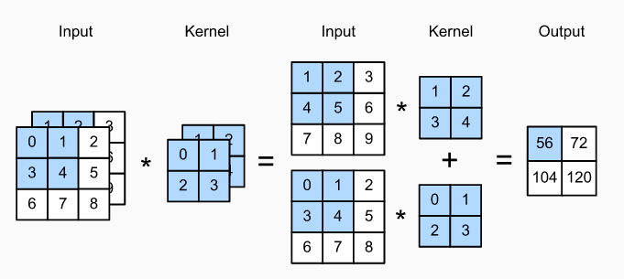
Multiple Input and Multiple Output Channels

Slide 24
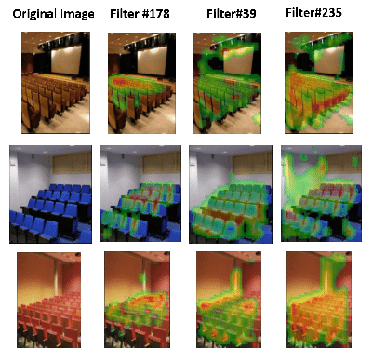
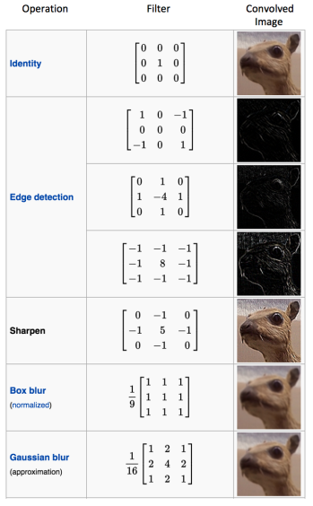
Multiple Output Channels

Slide 25
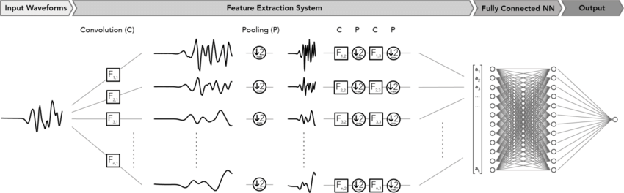
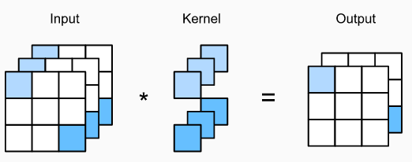
Multiple Output Channels

Slide 26
Convolutional Neural Networks
Finally, then there’s the bias term. The way the bias term works here is that each output filter has one bias term. The bias gets added to the output channel so far to produce the final output channel.
And with the single filter case down, the case for any number of filters is identical: Each filter processes the input with its own, different set of kernels and a scalar bias with the process described above, producing a single output channel. They are then concatenated together to produce the overall output, with the number of output channels being the number of filters. A nonlinearity is then usually applied before passing this as input to another convolution layer, which then repeats this process.
KNRTU-KAI | TU ILMENAU | Neural Networks

Slide 27
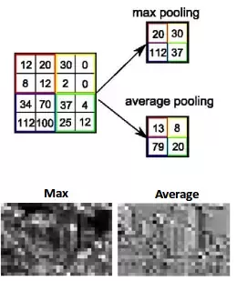
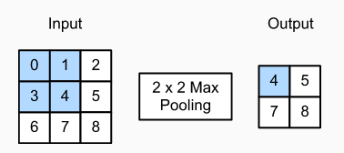
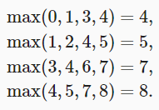
Maximum Pooling and Average Pooling
KNRTU-KAI | TU ILMENAU | Neural Networks

Slide 28
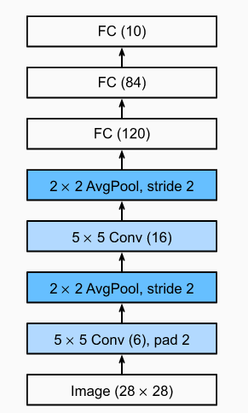
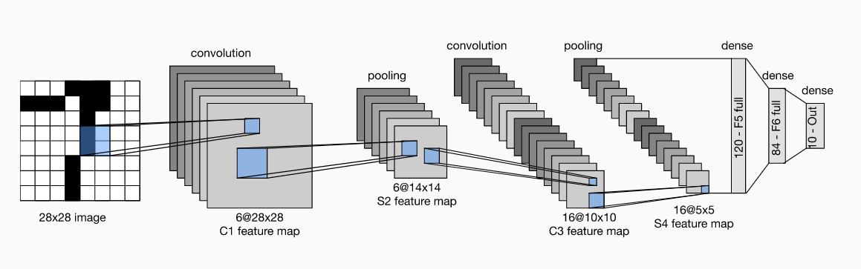
LeNet5
The LeNet5 CNN architecture was invented by Yann LeCun in 1998 and was the first CNN. It is a multilayered feed-forward network specifically designed to classify handwritten digits. It was used in LeCun's experiments and consists of seven layers containing trainable weights. The LeNet5 architecture looks like this:
The LeNet5 architecture consists of three convolutional layers and two alternating sequence pooling layers. The last two layers correspond to a traditional fully connected neural network, that is, a fully connected layer followed by an output layer. The main function of the output layer is to calculate the Euclidean distance between the input vector and the parameter vector. The output functions identify the difference between the measurements of the input pattern and our model. The output is kept minimal in order to achieve the best model. Therefore, the fully connected layer is configured so that the difference between the measurements of the input pattern and our model is minimized.

Slide 29
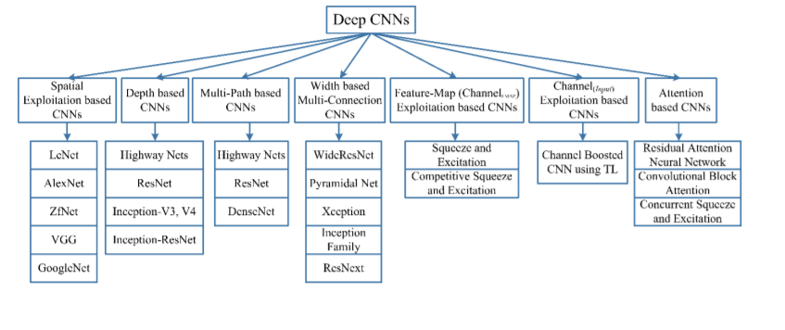

Modern deep CNN architectures

